Slide 1
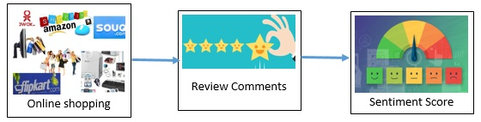

Sentimental Analysis Performance Advanced approaches of Machine Learning (Impacting People’s Daily lives with Products and Services Reviews)
Guided By
Ahmet Ozkul
Professor, Ph.D
University Of New Haven
Group Members :
Mohan Kamal Hassan
Vinay Mathukumalli

Slide 2
INDEX
Abstract
Introduction
Problem Statement
Literature Review
Proposed Methodology
Result, Comparison and Analysis
Conclusion
References

Slide 3
Abstract
Sentiment analysis or opinion mining is one of the major tasks of NLP (Natural Language Processing). Sentiment analysis has gained much attention in recent years. Sentiment analysis systems are being applied in almost every business and social domain because opinions are central to almost all human activities and are key influencers of our behaviors.
Our beliefs and perceptions of reality, and the choices we make, are largely conditioned on how others see and evaluate the world. For this reason, when we need to make a decision we often seek out the opinions of others. This is true not only for individuals but also for organizations.
For this reason, when we need to make a decision we often seek out the opinions of others. This is true not only for individuals but also for organizations. Experiments for both sentence-level categorization and review-level categorization are performed with promising outcomes.

Slide 4
Introduction
Objective: To determine the sentiment embedded in product reviews using computational methods.
Approaches: Utilizing two distinct sentiment analysis strategies:
A traditional method employing the AFINN sentiment score lexicon.
Advanced machine learning algorithms for a more nuanced analysis.
Scope: Analysis spans across different sentiment levels, from negative to positive (1 to 5 scale).
Tools: Implementing various R packages and tools for text mining, data manipulation, and machine learning.
Outcome: Aiming to accurately classify the sentiment of reviews and understand customer feedback.
Application: Enhancing customer experience and business insights through data-driven sentiment evaluation.

Slide 5
Problem Statement
As we know that there are several E-Commerce sites has been in the market with different products.
Thus there are so many reviews are being generated for only one product, thus the problem arises for the customers as well as E-Commerce company to understand the review
Though there is a star rating, most of the customers go through the reviews thus classifying the reviews with an appropriate accuracy is need to retain the customer.

Slide 6
So how to extract useful information and build objective products’ quality test system automatically to deal with the massive textual information is emerging in the related research field. Opinion Mining is a new technology based on the technology of text mining and natural language processing.
It provides the approach to generate summary of the products.It recognizes the opinion of the contents which authors, mainly discusses the sentence-level opinion mining and treats the statements of the product features for each viewpoint as analysis objects, then we can find authors’ opinion inclinations.

Slide 7
Literature Review
Paper title: “Sentiment analysis using product review data”
Author: Xing Fang and Justin Zhan
This paper, it explained that they aim to tackle the problem of sentiment polarity categorization, which is one of the fundamental problems of sentiment analysis.
A general process for sentiment polarity categorization is proposed with detailed process descriptions.
Data used in this study are online product reviews collected from Amazon.com.
Experiments for both sentence-level categorization and review-level categorization are performed with promising outcomes.

Slide 8
Paper title: “Mining the customer behavior using web usage mining in e-commerce”
Author: Yadav, M. P.
Explained customer behavior for E-commerce companies using K Mean.
With the drastic growth of WWW users can easily find, extract, filter and evaluated whatever they want.
With the advancement in technology servers are now able to collect and store a lot of data which can help them to know about customers perceptions.
Hence, to determine the relationship between web mining data and ecommerce. Consumers mostly prefer to choose among millions of ones in an online store to satisfy their demands instead to choose from a superstore. It shows that consumers have taken interest on e-commerce site to engage in international trade.

Slide 9
Paper title: “Web Mining Techniques in E-Commerce Applications”
Author: Ahmad Tasnim Siddiqui
Explained that today web is the best medium of communication in modern business. Now day’s online purchase has been increased as compared to window shopping as it provides millions of ranges.As, companies are able to attract most of the customers because ecommerce is not just buying and selling over internet but it also act as to get advantage on big giants of market.
For this purpose data mining sometimes called as knowledge discovery is used. As vast information has been provided on internet, it helps to improve e-commerce applications After that they explained the proposed architecture which contains mainly four components business data, data obtained from consumer’s interaction, data warehouse and data analysis. After finishing the task by data analysis module it’ll produce report which can be utilized by the consumers as well as the e-commerce application owners.

Slide 10
Proposed Methodology
Data Preprocessing: Cleaned and prepared the text data by tokenizing, removing stopwords, and stemming to ensure quality input for analysis.
Keyword-Based Analysis: Applied the AFINN lexicon to assign sentiment scores to individual words and aggregated these to determine the overall sentiment of each review.
Machine Learning Models: Trained multiple models including Logistic Regression, Naive Bayes, SVM, Random Forest, and XGBoost to classify sentiments into different levels.
Document-Term Matrix (DTM): Converted text reviews into a DTM to create a structured numerical representation of the text for machine learning processing.
Model Evaluation: Assessed the performance of each model using confusion matrices and ROC curves, evaluating their predictive accuracy and ability to generalize.
Binary and Multiclass Classification: Implemented Logistic Regression for binary (positive/negative) sentiment analysis and other models for multiclass (1 to 5 scale) sentiment rating.

Slide 11
NB Maxent Classifier:
The NB Maxent Entropy Classifier Another well-known classifier or Maxent as some people prefer to call it. The idea behind Maxent classifiers is that we are preferring is that the most uniform models that satisfy any given constraint. Maxent models are feature based models. We use these features (Based on product reviews which are based on product features) to find a distribution over the different classes using logistic regression (as an accuracy value).
The probability of a data point belonging to a particular class is calculated for measuring the accuracy of Maxent with respect to the parameters they are Precision, Recall and Fscore. Through which we can decide and identify its accuracy in classification process.

Slide 12
NB Tree Classifier:
The NB Boosted tree is a classifier that is basically a combination of Boosting and Decision Trees. Boosting is a machine Meta learning algorithm for reducing ambiguity in supervised learning. In Boosting predictive classifiers are used to develop weighted trees (classes of positive negative and neutral) which are further combined into single prediction accuracy value, which is based on the three parameters they are (Precision, Recall and Fscore).
Boosted trees combine the strengths of two algorithms and provide the accuracy value, through which we can decide and identify its accuracy in classification process.

Slide 13
NB Support Vector Machine (SVM) Classifier:
The NB Support Vector Machine algorithm has defined input and output format. Input is a vector space and output is 0 or 1 (positive/negative). Text reviews (particularly the user reviews for the product purchased) in original form are not suitable for learning. They are transformed into format which matches into input of machine learning algorithm input. For this pre-processing on text reviews is carried out. Then we carryout transformation.
Each word will correspond or belong to one class (the classes will be positive, negative and neutral) and identical words (which bears same meaning) belong to same classes. As we can calculate the TF-IDF for this purpose. Such that the accuracy of support vector machine algorithm can be identified and made a suitable comparison with other algorithms.

Slide 14
NB Random Forest Classifier:
The NB Random forests is an ensemble learning method for classification that operate by constructing a vector of classes from the pool of words consisting of different classes. It produces multi-altitude decision based on the parameters on which the classifying accuracy value are depended. The correlation between classes is reduced by randomly selecting the bag or pool of words and thus the prediction power increases and leads to increase in efficiency.
The predictions are made by aggregating the predictions of various ensemble data sets consisting of different classes. Such that the accuracy of support vector machine algorithm can be identified and made a suitable comparison with other algorithms.

Slide 15
NB Bagging Classifier:
The NB Bagging is an ensemble machine learning technique which Employs simplest way of combining predictions that belong to the same type of classes, by differentiating the level of categorization in the process of identifying the text level representation of the word belong to which class of category that is (Positive, negative and neutral). Such that bagging method incorporate the process of identifying the classifier from the given dataset.
Therefore, improves the performances by identifying the different classifier belong to which class. Thus, with the parameter we can determine the accuracy in terms of value, so that in future we can use the bagging technique for sentiment analysis of product reviews.

Slide 16
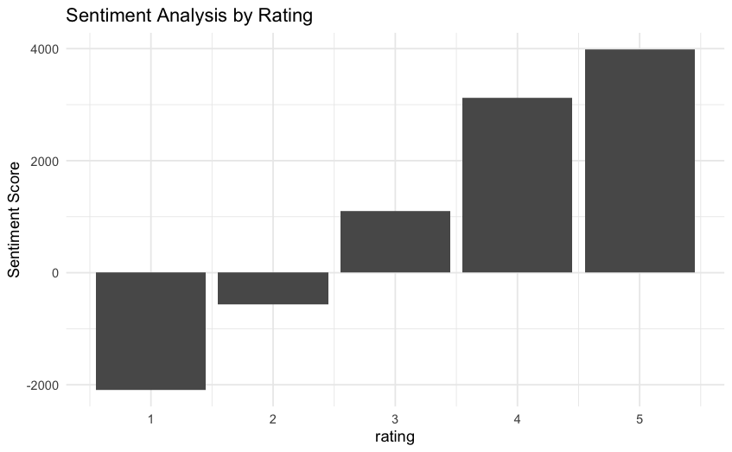
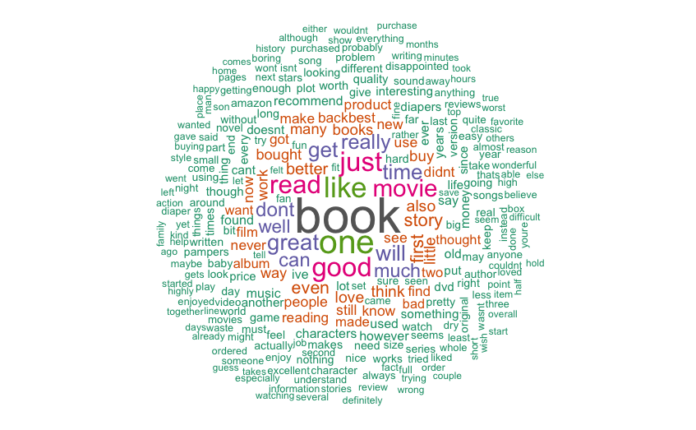
Results, Comparison and Analysis
Ratings / Wordcloud
Aggregated sentiment scores for each rating level. There are more instances of positive sentiments than negative sentiments.

Slide 17

Sentimental Analysis
1 - Keyword Based Analysis
The AFINN lexicon is a list of words each rated with a sentiment score, reflecting the positivity or negativity of the word.
Reviews are scanned, and words are matched with the AFINN lexicon to assign a sentiment score based on the lexicon’s predefined ratings.
Individual word scores are summed to determine an overall sentiment score for each review, indicating its positive or negative nature.

Slide 18
Sentimental Analysis
2 – NB and Machine Learning Classifiers
Machine learning models are used to predict the sentiment of reviews beyond simple positive or negative, often categorizing into multiple levels of sentiment.
Textual data is transformed into numerical form through a Document-Term Matrix (DTM) to facilitate machine learning.
Sparse columns in the Document-Term Matrix, where terms appear in less than 2% of the documents, are removed to reduce noise and computational complexity, enhancing model performance.
Each model is trained using a subset of the data (training set - 80% of total data) to learn the patterns associated with various sentiment levels, and evaluated on testing set (remaining 20% data).

Slide 19
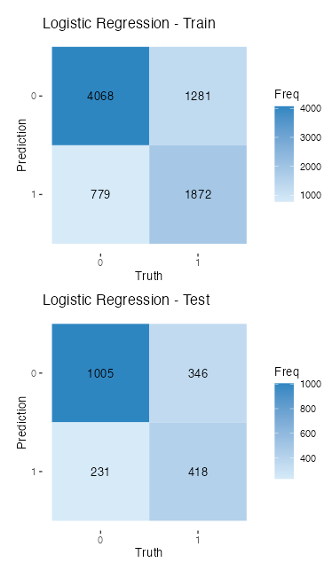
Sentimental Analysis
Logistic Regression Classifer
The Logistic Regression classifier achieved a solid accuracy of 71.15% in sentiment classification.
High sensitivity (recall) at 81.31% suggests the model is very good at identifying positive reviews but less effective in recognizing negative sentiments, with a specificity of 54.71%.
The model's precision is robust at 74.39%.
Balanced accuracy is at 68.01%, reflecting a reasonable trade-off between sensitivity and specificity across both sentiment classes.
The Matthew's Correlation Coefficient (MCC) stands at 0.3738, indicating that the classifier's performance is better than a random guess but still has room for improvement.

Slide 20
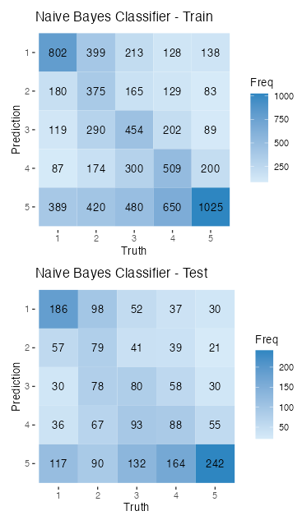
Sentimental Analysis
Naive Bayes Classifier and Random Forest
The Naive Bayes classifier achieved an overall accuracy of 33.75%, indicating a moderate level of performance in multi-class sentiment classification.
The sensitivity (recall) across classes is at 33.95%, suggesting that the model has a uniform but moderate ability to identify all sentiment classes correctly.
The model's balanced accuracy, which averages sensitivity and specificity, is 58.72%, showing that performance is not uniform across classes.
The Matthew's Correlation Coefficient (MCC) for the multi-class classification is 0.1792, which is low and suggests that there's considerable room for improvement in the model's predictive capability.
The model's precision (ppv) is low at 33.38%, indicating challenges in the accuracy of predictions across the various sentiment classes.

Slide 21
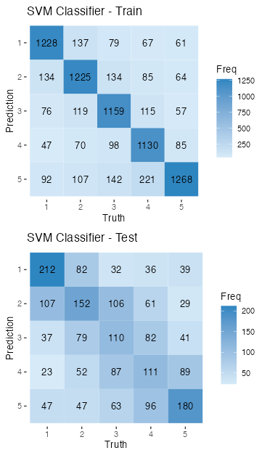
Sentimental Analysis
NB and Support Vector Machines
The Support Vector Machine (SVM) classifier shows an accuracy of 38.25% in multi-class sentiment classification, suggesting a modest ability to correctly classify sentiment levels.
With a balanced accuracy of 61.35%, the SVM classifier demonstrates a moderate level of consistency in correctly identifying sentiment across different classes.
The sensitivity (recall) and precision (ppv) of the model are both around 38%, indicating that the model has a fair rate of correctly identifying true positives for each class and that its positive predictions are correct at a similar rate.
The Matthew's Correlation Coefficient (MCC) at 0.2283 reflects a low but better than random correlation between the observed and predicted classifications.
The relatively low detection prevalence of 20% indicates that the model is quite selective in predicting the positive class, potentially leading to a higher number of false negatives.

Slide 22
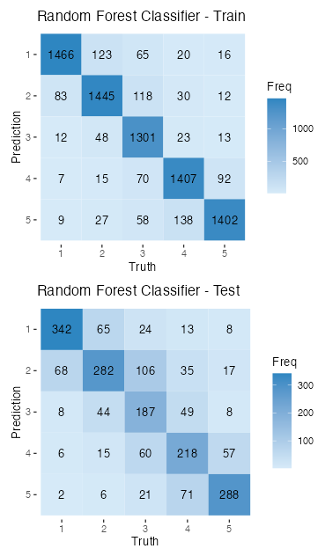
Sentimental Analysis
NB and Random Forest Classifier
The Random Forest classifier demonstrates strong performance with an accuracy of 65.85%, indicating it is well-suited for multi-class sentiment classification.
High balanced accuracy of 78.56% suggests a consistent performance by the model in identifying various sentiment classes.
The model achieves a good sensitivity (recall) and precision (ppv), both approximately 65.87%, showing its effectiveness in correctly identifying and predicting sentiment classes.
The Matthew's Correlation Coefficient (MCC) is robust at 0.5745, suggesting a strong correlation between the observed and predicted classifications, well above what would be expected by chance.
The model's specificity is very high at 91.45%, indicating it is very effective at correctly identifying negative cases for each sentiment class.

Slide 23
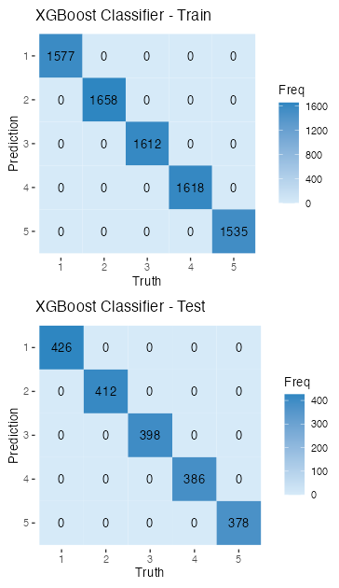
Sentimental Analysis
XGBoost Classifier
The XGBoost classifier has achieved perfect performance metrics across the board on the training set, indicating that it has learned to classify the training data with 100% accuracy.
For the training data, every metric including accuracy, sensitivity (recall), specificity, precision (ppv), and Matthew's Correlation Coefficient (MCC) scored a maximum of 1.0, implying no misclassification.
The confusion matrix for the training data shows complete accuracy with no instances of false positives or false negatives, which may suggest overfitting to the training data.
The confusion matrix for the testing data also shows full 100% accuracy as indicated by zeros in non-diagonal cells.
The detection prevalence of 0.2 shows that the model has a tendency to predict positive cases at a rate of 20%, which is consistent across both the training and test sets.

Slide 24
Sentimental Analysis
Conclusion
The project showcased the use of various advanced hybrid machine learning models to analyze sentiment in product reviews with different levels of effectiveness.
Machine learning models, notably NB and Random Forest and XGBoost, outperformed the traditional keyword-based method, providing a deeper analysis of sentiments.
NB hybrid Random Forest demonstrated high accuracy and robust performance, marking it as a reliable classifier for sentiment analysis tasks.
Nb with XGBoost achieved perfect scores on training data but the perfectness may indicate potential overfitting issues.

Slide 25
References
[1] S. ChandraKala1 and C. Sindhu2, “OPINION MINING AND SENTIMENT CLASSIFICATION: A SURVEY,”.Vol .3(1),Oct-2012,420-427.
[2] Kim S-M, Hovy E (2004) Determining the sentiment of opinions In: Proceedings of the 20th international conference on Computational Linguistics, page 1367.Association for Computational Linguistics, Strasbourg, PA, USA.
[3] Liu B (2010) Sentiment analysis and subjectivity In: Handbook of Natural Language Processing, Second Edition.. Taylor and Francis Group, Boca
[4] Liu B, Hu M, Cheng J (2005) Opinion observer: Analyzing and comparing opinions on the web In: Proceedings of the 14th International Conference on World Wide Web, WWW ’05, 342–351.ACM, New York, NY, USA.

Slide 26
[5] Pang B, Lee L (2004) A sentimental education: Sentiment analysis using subjectivity summarization based on minimum cuts In: Proceedings of the 42Nd Annual Meeting on Association for Computational Linguistics, ACL ’04.Association for Computational Linguistics, Stroudsburg, PA, USA
[6] Liu B, Hu M, Cheng J (2005) Opinion observer: Analyzing and comparing opinions on the web In: Proceedings of the 14th International Conference on World Wide Web, WWW ’05, 342–351..ACM, New York, NY, USA.
[7] Pang B, Lee L (2004) A sentimental education: Sentiment analysis using subjectivity summarization based on minimum cuts In: Proceedings of the 42Nd Annual Meeting on Association for Computational Linguistics, ACL ’04..Association for Computational Linguistics, Stroudsburg, PA, USA.

Slide 27
THANK YOU

